Slide 1
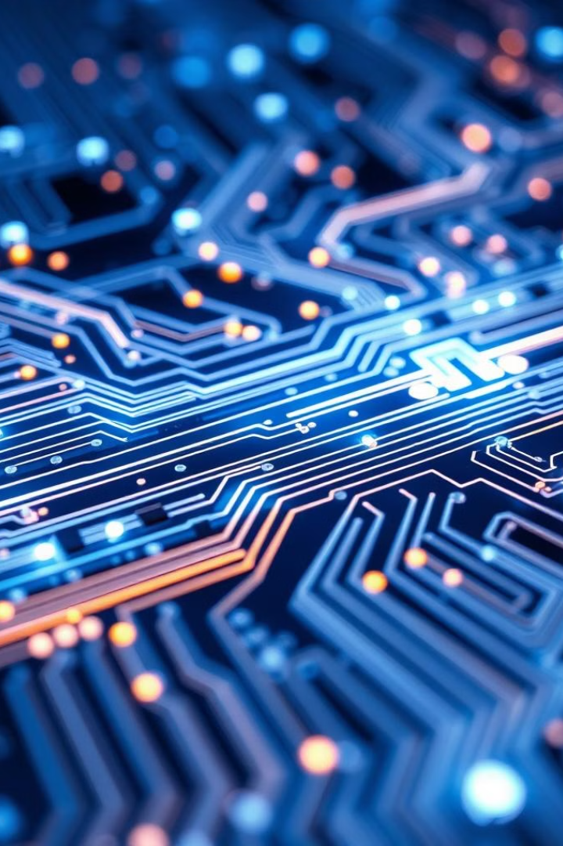
Quantum Computing: The Next Computing Revolution
Quantum computing promises to revolutionize the way we process information, solve complex problems, and push the boundaries of what's possible with technology. This presentation will explore the fundamentals of quantum computing and its potential impact on the world.
AA
by Akhileshwar Anumula

Slide 2

Quantum Computing Basics
1
Quantum Mechanics
2
Probabilistic Computation
Quantum computing is based on the principles of quantum mechanics, which describe the behavior of matter and energy at the atomic and subatomic levels.
Quantum computers use qubits, which can exist in superposition of states, allowing them to process information probabilistically rather than the binary approach of classical computers.
3
Exponential Potential
Quantum computers have the potential to solve certain problems exponentially faster than classical computers, with applications in cryptography, drug discovery, and more.

Slide 3

Qubits and Superposition
1
Qubits
The fundamental building blocks of quantum computers are qubits, which can represent both 0 and 1 simultaneously, unlike classical bits.
2
Superposition
Qubits can exist in a superposition of states, allowing quantum computers to explore multiple possibilities in parallel, leading to their exponential potential.
3
Measurement
When a qubit is measured, it collapses to a definite 0 or 1 state, which is a key aspect of the probabilistic nature of quantum computing.

Slide 4
Quantum Entanglement
Correlated Qubits
Nonlocal Interactions
Potential Applications
Quantum entanglement allows qubits to become "entangled," where the state of one qubit is correlated with the state of another, even if they are physically separated.
Entanglement enables nonlocal interactions, where actions on one qubit instantly affect the other, even across vast distances, defying classical intuitions about causality.
Quantum entanglement is a critical resource for many quantum algorithms and protocols, with potential applications in secure communication, cryptography, and metrology.

Slide 5
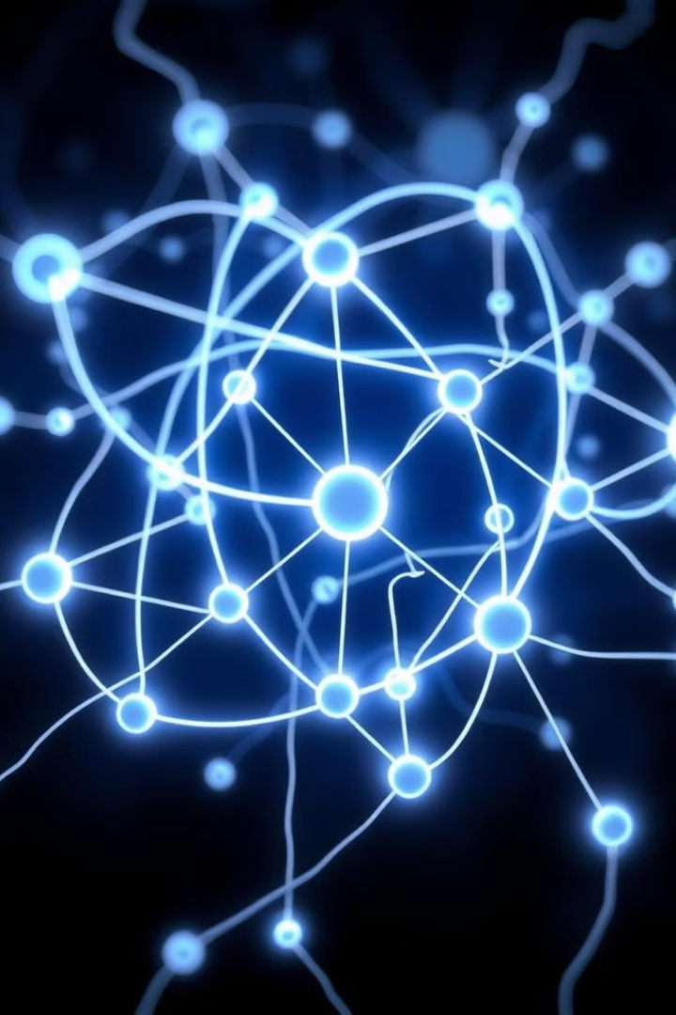
Quantum Gates and Circuits
1
Quantum Gates
Quantum computers use quantum gates, which are the fundamental building blocks for performing operations on qubits, similar to classical logic gates.
2
Quantum Circuits
Quantum circuits are composed of quantum gates arranged in a specific sequence to perform complex quantum algorithms and computations.
3
Reversibility
Quantum gates and circuits must be reversible, as information cannot be lost in the quantum world, unlike classical computing where information can be erased.

Slide 6
Quantum Computing Hardware
IBM Quantum Systems
Google Quantum Supremacy
Quantum Hardware Challenges
IBM has been at the forefront of quantum computing, developing a series of quantum processors and cloud-based quantum computing services.
In 2019, Google's Sycamore processor demonstrated quantum supremacy, performing a specific computation faster than the world's most powerful classical supercomputer.
Maintaining the delicate quantum states required for computation is a major challenge, requiring advanced cooling and isolation technologies.

Slide 7
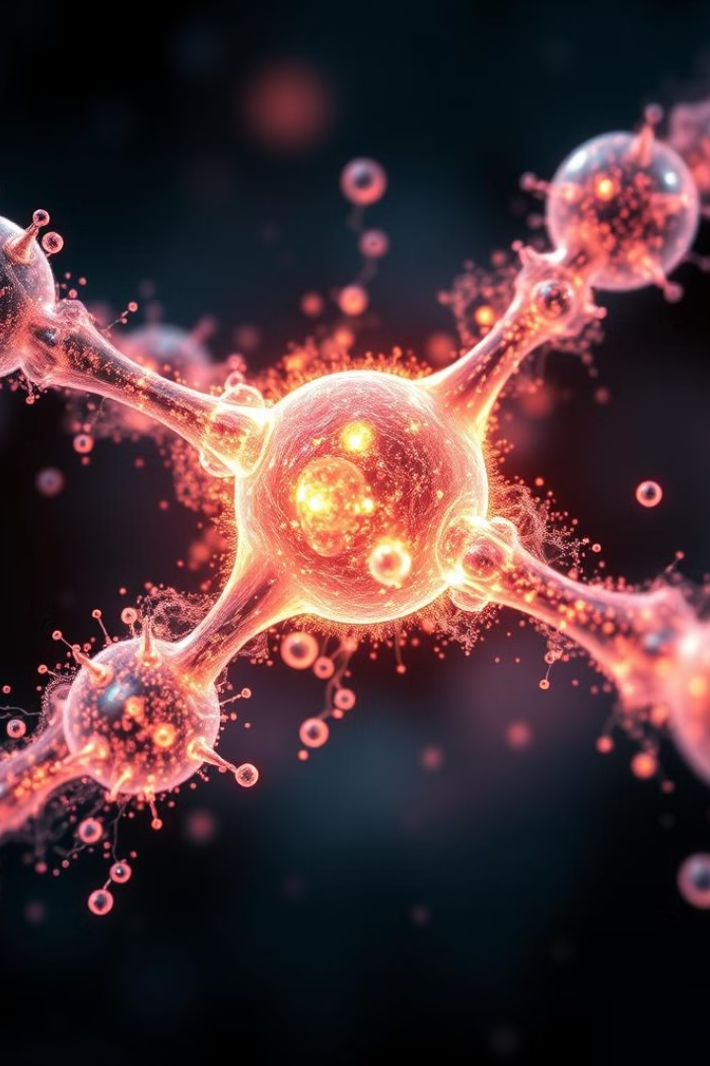


Applications: Cryptography and Drug Discovery
Cryptography
Drug Discovery
Quantum computers can break many of the encryption algorithms used to secure modern communications, leading to the development of quantum-resistant cryptography.
Quantum computers can simulate complex molecular interactions and chemical reactions, accelerating the discovery and development of new drugs and materials.

Slide 8
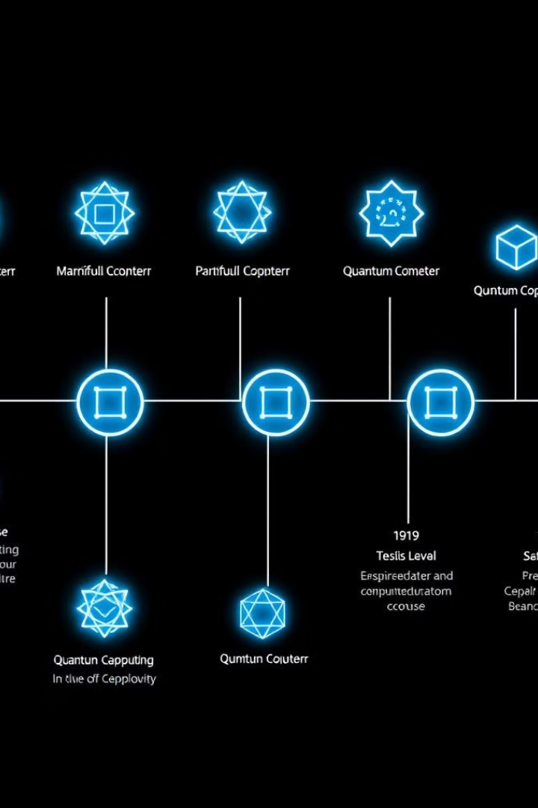
Quantum Supremacy Achievements
1
Google's Sycamore
In 2019, Google's Sycamore processor performed a specific computation 200 seconds, faster than the world's most powerful classical supercomputer.
2
Quantum Advantage
Researchers have demonstrated quantum advantage in various tasks, including simulating quantum systems, optimization problems, and machine learning.
3
Continued Progress
Quantum computing hardware and algorithms continue to evolve, with increasing qubit counts, improved error correction, and new applications being explored.

Slide 9

Challenges in Quantum Computing
Qubit Fragility
Decoherence
Qubits are extremely fragile and sensitive to environmental disturbances, making them challenging to maintain and control.
Qubits tend to lose their quantum state over time, a process known as decoherence, which limits the time available for computation.
Error Correction
Scalability
Developing effective error correction techniques is crucial to overcome the inherent noise and instability of quantum systems.
Scaling up quantum computers to tackle larger and more complex problems remains a significant technical challenge.

Slide 10




The Future of Quantum Computing
Continued Innovation
Rapid advancements in quantum hardware, software, and algorithms are expected to drive the field forward in the coming years.
Commercialization
As quantum computers become more powerful and practical, they are expected to find commercial applications in various industries.
Societal Impact
Quantum computing has the potential to revolutionize fields like cryptography, drug discovery, materials science, and beyond, with far-reaching societal implications.

